Slide 1
LALP unit 4
DR. Pradeep . J. .Jha

Slide 2
LALP 4.1
System of linear Equations:
We have a system of two linear equations in R² which shows two lines. Either they are parallel or they intersect at one point only. This is the point of intersection of two lines. It means that the coordinate of that point will satify equation of both lines.
We would like to identify such situations using the notion of ‘ inverse of a matrix’.
We consider two examples in order to verify existence of point of intersection.
General approach:
Consider a1x + b1y = c1 …(1)
and a2x + b2y = c2 . .. (2)

Slide 3
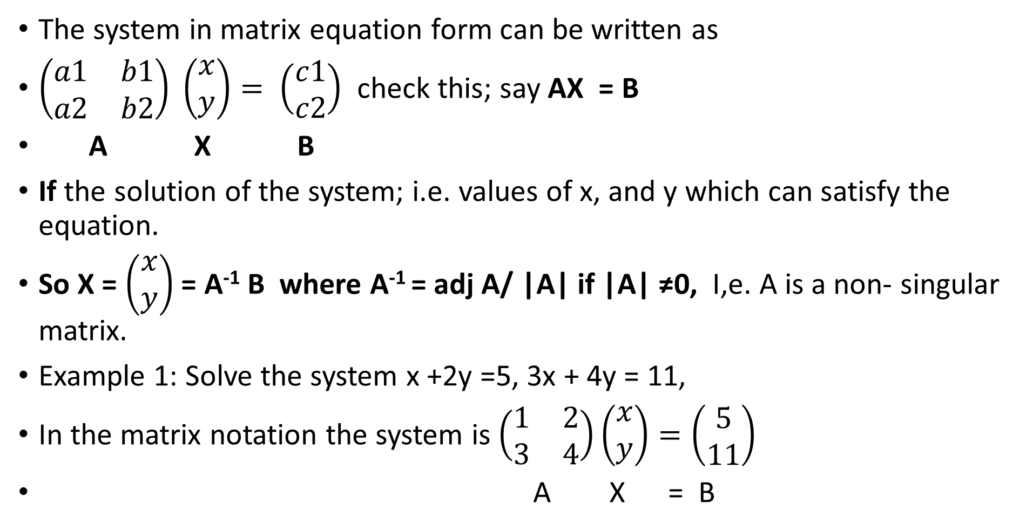
LALP 4.2
The system in matrix equation form can be written as
$\left(\begin{matrix}a1 & b1 \\ a2 & b2\end{matrix}\right) \left(\begin{matrix}x \\ y\end{matrix}\right)= \left(\begin{matrix}c1 \\ c2\end{matrix}\right)$ check this; say AX = B
A X B
If the solution of the system; i.e. values of x, and y which can satisfy the equation.
So X = $\left(\begin{matrix}x \\ y\end{matrix}\right)$ = A⁻¹ B where A⁻¹ = adj A/ |A| if |A| ≠0, I,e. A is a non- singular matrix.
Example 1: Solve the system x +2y =5, 3x + 4y = 11,
In the matrix notation the system is $\left(\begin{matrix}1 & 2 \\ 3 & 4\end{matrix}\right)\left(\begin{matrix}x \\ y\end{matrix}\right)=\left(\begin{matrix}5 \\ 11\end{matrix}\right)$
A X = B

Slide 4
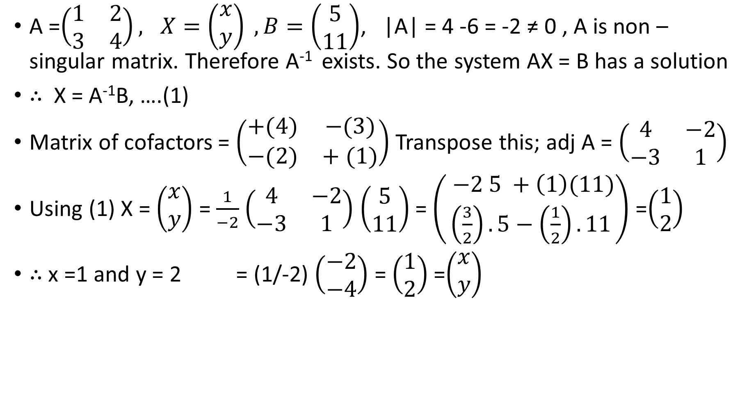
LALP 4.3
A =$\left(\begin{matrix}1 & 2 \\ 3 & 4\end{matrix}\right), X=\left(\begin{matrix}x \\ y\end{matrix}\right) ,B=\left(\begin{matrix}5 \\ 11\end{matrix}\right)$, |A| = 4 -6 = -2 ≠ 0 , A is non –singular matrix. Therefore A⁻¹ exists. So the system AX = B has a solution
$∴$ X = A⁻¹B, ….(1)
Matrix of cofactors = $\left(\begin{matrix}+(4) & −(3) \\ −(2) & + (1)\end{matrix}\right)$ Transpose this; adj A = $\left(\begin{matrix}4 & −2 \\ −3 & 1\end{matrix}\right)$
Using (1) X = $\left(\begin{matrix}x \\ y\end{matrix}\right)$ = $\frac{1}{−2}$ $\left(\begin{matrix}4 & −2 \\ −3 & 1\end{matrix}\right)$ $\left(\begin{matrix}5 \\ 11\end{matrix}\right)$ = $\left(\begin{matrix} −2 5 +\left(1\right)(11) \\ \left(\frac{3}{2}\right). 5−\left(\frac{1}{2}\right). 11\end{matrix}\right)$ =$\left(\begin{matrix}1 \\ 2\end{matrix}\right)$
$∴$ x =1 and y = 2 = (1/-2) $\left(\begin{matrix}−2 \\ −4\end{matrix}\right)$ = $\left(\begin{matrix}1 \\ 2\end{matrix}\right)$ =$\left(\begin{matrix}x \\ y\end{matrix}\right)$

Slide 5
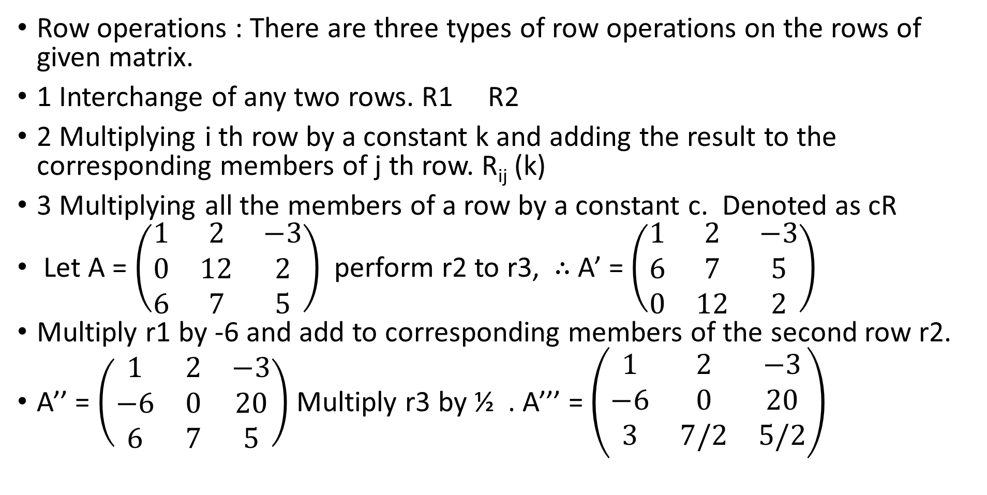
LALP 4.4
Row operations : There are three types of row operations on the rows of given matrix.
1 Interchange of any two rows. R1 R2
2 Multiplying i th row by a constant k and adding the result to the corresponding members of j th row. R_{ij} (k)
3 Multiplying all the members of a row by a constant c. Denoted as cR
Let A = $\left(\begin{matrix}1 & 2 & −3 \\ 0 & 12 & 2 \\ 6 & 7 & 5\end{matrix}\right)$ perform r2 to r3, $∴$ A’ = $\left(\begin{matrix}1 & 2 & −3 \\ 6 & 7 & 5 \\ 0 & 12 & 2\end{matrix}\right)$
Multiply r1 by -6 and add to corresponding members of the second row r2.
A’’ = $\left(\begin{matrix}1 & 2 & −3 \\ −6 & 0 & 20 \\ 6 & 7 & 5\end{matrix}\right)$ Multiply r3 by ½ . A’’’ = $\left(\begin{matrix}1 & 2 & −3 \\ −6 & 0 & 20 \\ 3 & 7/2 & 5/2\end{matrix}\right)$

Slide 6
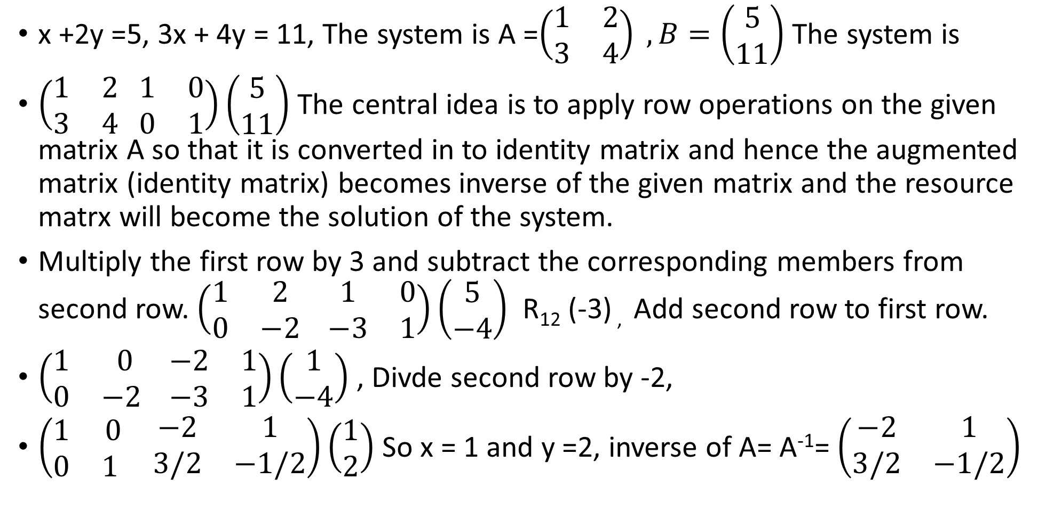
LALP 4.5
x +2y =5, 3x + 4y = 11, The system is A =$\left(\begin{matrix}1 & 2 \\ 3 & 4\end{matrix}\right) ,B=\left(\begin{matrix}5 \\ 11\end{matrix}\right)$ The system is
$\left(\begin{matrix}1 & 2 \\ 3 & 4\end{matrix} \begin{matrix}1 & 0 \\ 0 & 1\end{matrix}\right)\left(\begin{matrix}5 \\ 11\end{matrix}\right)$ The central idea is to apply row operations on the given matrix A so that it is converted in to identity matrix and hence the augmented matrix (identity matrix) becomes inverse of the given matrix and the resource matrx will become the solution of the system.
Multiply the first row by 3 and subtract the corresponding members from second row. $\left(\begin{matrix}1 & 2 \\ 0 & −2\end{matrix} \begin{matrix}1 & 0 \\ −3 & 1\end{matrix}\right)\left(\begin{matrix}5 \\ −4\end{matrix}\right)$ R₁₂ (-3) , Add second row to first row.
$\left(\begin{matrix}1 & 0 \\ 0 & −2 \end{matrix} \begin{matrix}−2 & 1 \\ −3 & 1\end{matrix}\right)\left(\begin{matrix}1 \\ −4\end{matrix}\right)$ , Divde second row by -2,
$\left(\begin{matrix}1 & 0 \\ 0 & 1 \end{matrix} \begin{matrix}−2 & 1 \\ 3/2 & −1/2\end{matrix}\right)\left(\begin{matrix}1 \\ 2\end{matrix}\right)$ So x = 1 and y =2, inverse of A= A⁻¹= $\left(\begin{matrix}−2 & 1 \\ 3/2 & −1/2\end{matrix}\right)$

Slide 7
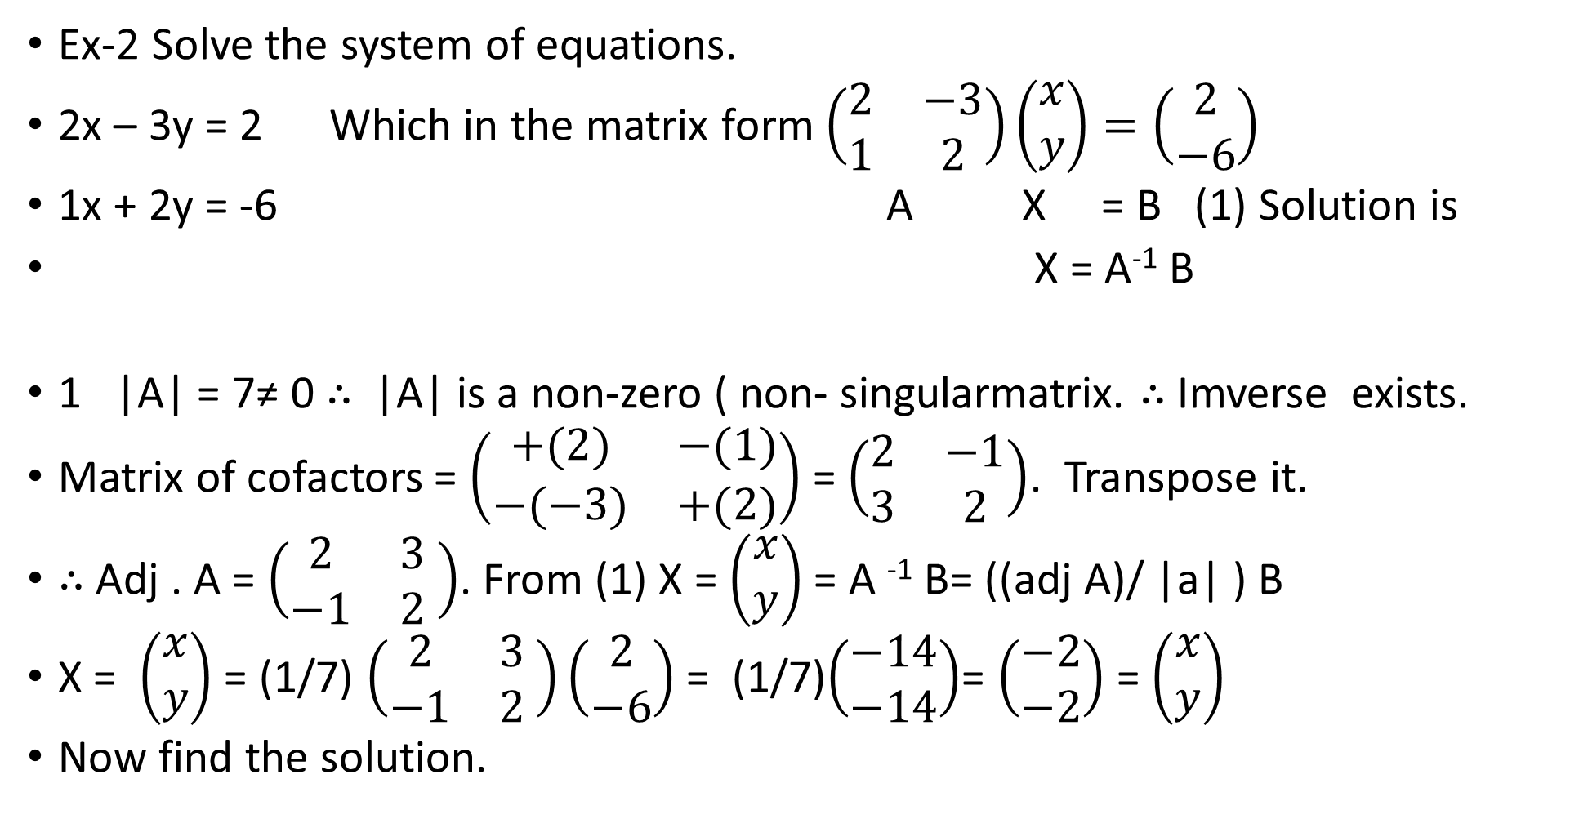
LALP 4.6
Ex-2 Solve the system of equations.
2x – 3y = 2 Which in the matrix form $\left(\begin{matrix}2 & −3 \\ 1 & 2\end{matrix}\right)\left(\begin{matrix}x \\ y\end{matrix}\right)=\left(\begin{matrix}2 \\ −6\end{matrix}\right)$
1x + 2y = -6 A X = B (1) Solution is
X = A⁻¹ B
1 |A| = 7≠ 0 $∴$ |A| is a non-zero ( non- singularmatrix. $∴$ Imverse exists.
Matrix of cofactors = $\left(\begin{matrix}+(2) & −(1) \\ −(−3) & +(2)\end{matrix}\right)$ = $\left(\begin{matrix}2 & −1 \\ 3 & 2\end{matrix}\right)$. Transpose it.
$∴$ Adj . A = $\left(\begin{matrix}2 & 3 \\ −1 & 2\end{matrix} \right)$. From (1) X = $\left(\begin{matrix}x \\ y\end{matrix}\right)$ = A ⁻¹ B= ((adj A)/ |a| ) B
X = $\left(\begin{matrix}x \\ y\end{matrix}\right)$ = (1/7) $\left(\begin{matrix}2 & 3 \\ −1 & 2\end{matrix} \right)\left(\begin{matrix}2 \\ −6\end{matrix}\right)$ = (1/7)$\left(\begin{matrix}−14 \\ −14\end{matrix}\right)$= $\left(\begin{matrix}−2 \\ −2\end{matrix}\right)$ = $\left(\begin{matrix}x \\ y\end{matrix}\right)$
Now find the solution.

Slide 8
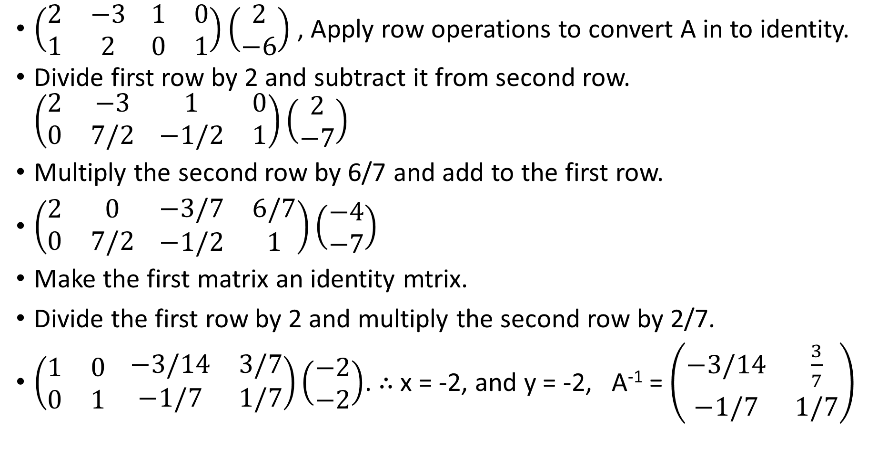
LALP 4.7
$\left(\begin{matrix}2 & −3 \\ 1 & 2\end{matrix} \begin{matrix}1 & 0 \\ 0 & 1\end{matrix}\right)\left(\begin{matrix}2 \\ −6\end{matrix}\right)$ , Apply row operations to convert A in to identity.
Divide first row by 2 and subtract it from second row. $\left(\begin{matrix}2 & −3 \\ 0 & 7/2\end{matrix} \begin{matrix}1 & 0 \\ −1/2 & 1\end{matrix}\right)\left(\begin{matrix}2 \\ −7\end{matrix}\right)$
Multiply the second row by 6/7 and add to the first row.
$\left(\begin{matrix}2 & 0 \\ 0 & 7/2\end{matrix} \begin{matrix}−3/7 & 6/7 \\ −1/2 & 1\end{matrix}\right)\left(\begin{matrix}−4 \\ −7\end{matrix}\right)$
Make the first matrix an identity mtrix.
Divide the first row by 2 and multiply the second row by 2/7.
$\left(\begin{matrix}1 & 0 \\ 0 & 1\end{matrix} \begin{matrix}−3/14 & 3/7 \\ −1/7 & 1/7\end{matrix}\right)\left(\begin{matrix}−2 \\ −2\end{matrix}\right)$. $∴$ x = -2, and y = -2, A⁻¹ = $\left(\begin{matrix}−3/14 & \frac{3}{7} \\ −1/7 & 1/7\end{matrix}\right)$

Slide 9
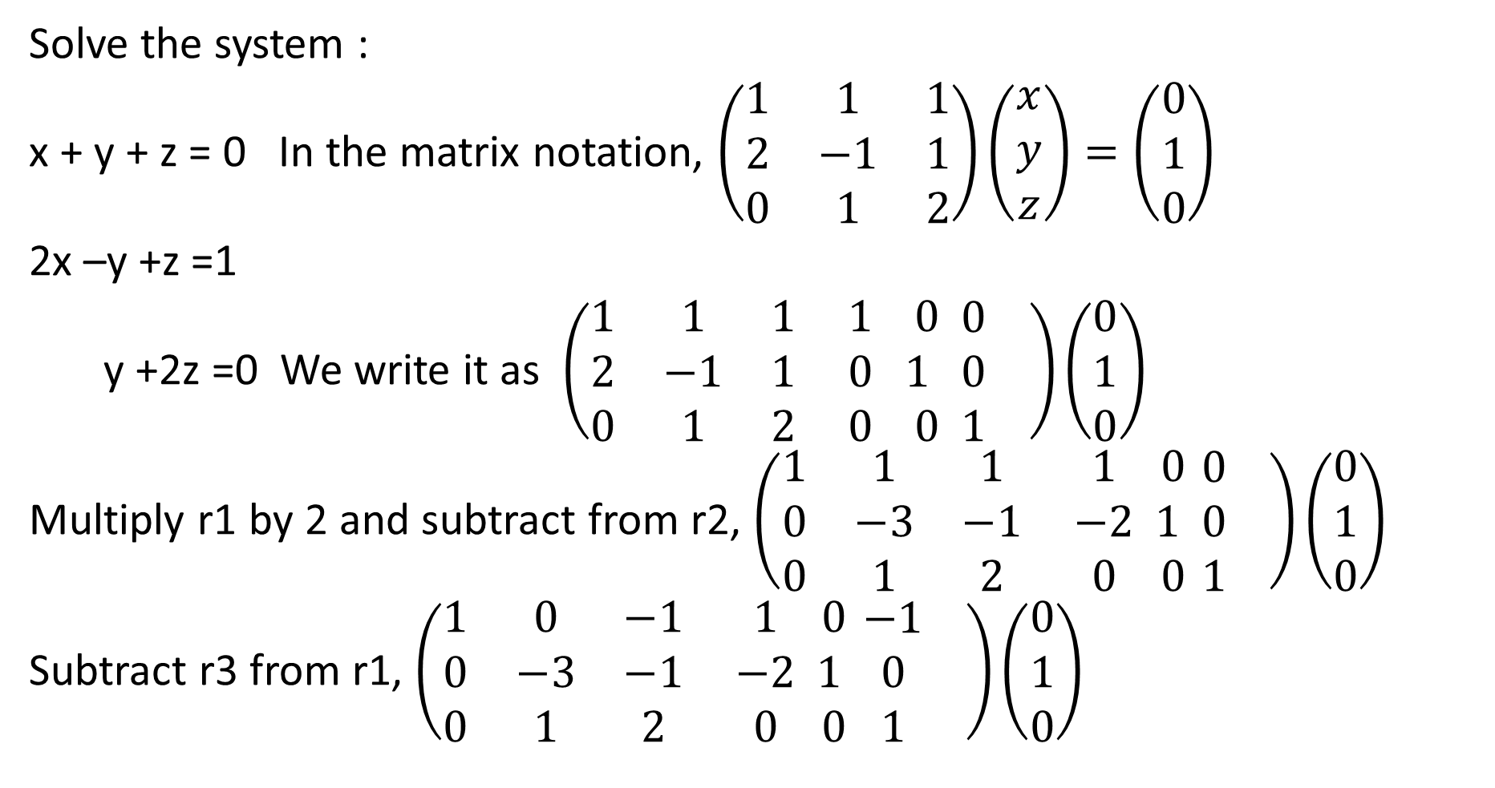
LALP 4.8
Solve the system :
x + y + z = 0 In the matrix notation, $\left(\begin{matrix}1 & 1 & 1 \\ 2 & −1 & 1 \\ 0 & 1 & 2\end{matrix}\right)\left(\begin{matrix}x \\ y \\ z\end{matrix}\right)=\left(\begin{matrix}0 \\ 1 \\ 0\end{matrix}\right)$
2x –y +z =1
y +2z =0 We write it as $\left(\begin{matrix}1 & 1 & 1 \\ 2 & −1 & 1 \\ 0 & 1 & 2\end{matrix} \begin{matrix}1 \\ 0 \\ 0\end{matrix} \begin{matrix}0 \\ 1 \\ 0\end{matrix} \begin{matrix}0 \\ 0 \\ 1\end{matrix} \right)\left(\begin{matrix}0 \\ 1 \\ 0\end{matrix}\right)$
Multiply r1 by 2 and subtract from r2, $\left(\begin{matrix}1 & 1 & 1 \\ 0 & −3 & −1 \\ 0 & 1 & 2\end{matrix} \begin{matrix}1 \\ −2 \\ 0\end{matrix} \begin{matrix}0 \\ 1 \\ 0\end{matrix} \begin{matrix}0 \\ 0 \\ 1\end{matrix} \right)\left(\begin{matrix}0 \\ 1 \\ 0\end{matrix}\right)$
Subtract r3 from r1, $\left(\begin{matrix}1 & 0 & −1 \\ 0 & −3 & −1 \\ 0 & 1 & 2\end{matrix} \begin{matrix}1 \\ −2 \\ 0\end{matrix} \begin{matrix}0 \\ 1 \\ 0\end{matrix} \begin{matrix}−1 \\ 0 \\ 1\end{matrix} \right)\left(\begin{matrix}0 \\ 1 \\ 0\end{matrix}\right)$

Slide 10
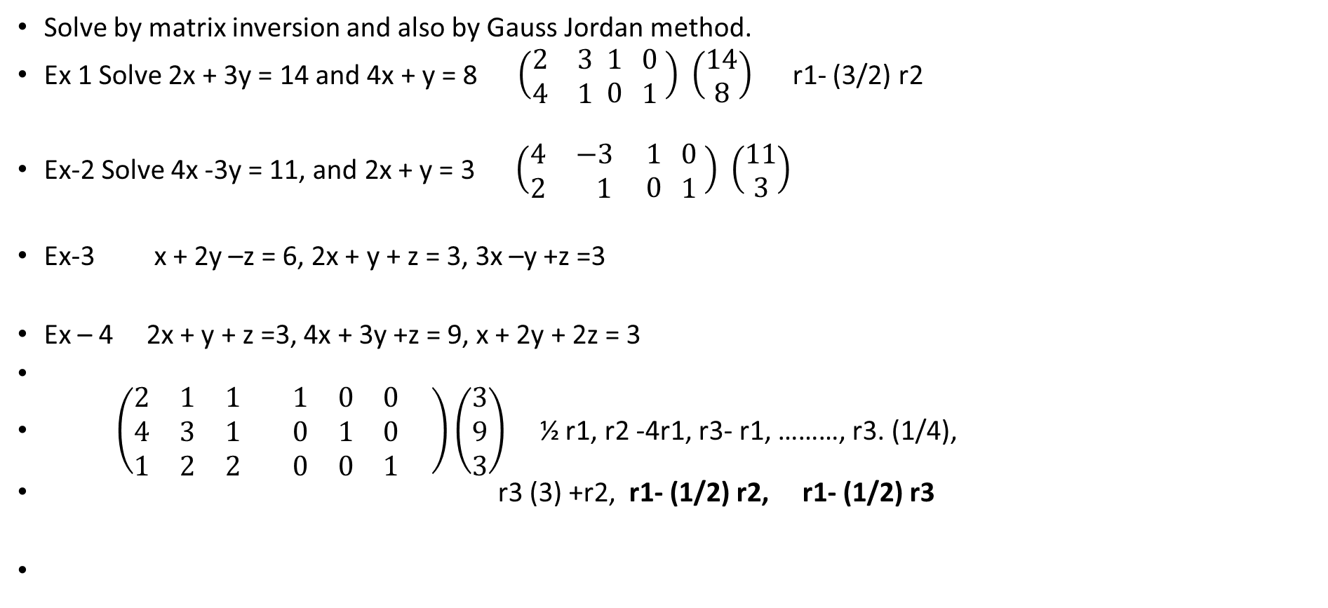
LALP 4.9
Solve by matrix inversion and also by Gauss Jordan method.
Ex 1 Solve 2x + 3y = 14 and 4x + y = 8 $\left(\begin{matrix}2 & 3 \\ 4 & 1\end{matrix} \begin{matrix}1 \\ 0\end{matrix} \begin{matrix}0 \\ 1\end{matrix} \right)$ $\left(\begin{matrix}14 \\ 8\end{matrix}\right)$ r1- (3/2) r2
Ex-2 Solve 4x -3y = 11, and 2x + y = 3 $\left(\begin{matrix}4 & −3 \\ 2 & 1\end{matrix} \begin{matrix}1 \\ 0\end{matrix} \begin{matrix}0 \\ 1\end{matrix} \right)$ $\left(\begin{matrix}11 \\ 3\end{matrix}\right)$
Ex-3 x + 2y –z = 6, 2x + y + z = 3, 3x –y +z =3
Ex – 4 2x + y + z =3, 4x + 3y +z = 9, x + 2y + 2z = 3
$\left(\begin{matrix}2 & 1 & 1 \\ 4 & 3 & 1 \\ 1 & 2 & 2\end{matrix} \begin{matrix}1 & 0 & 0 \\ 0 & 1 & 0 \\ 0 & 0 & 1\end{matrix} \right)\left(\begin{matrix}3 \\ 9 \\ 3\end{matrix}\right)$ ½ r1, r2 -4r1, r3- r1, ………, r3. (1/4),
r3 (3) +r2, r1- (1/2) r2, r1- (1/2) r3

